Slide 1
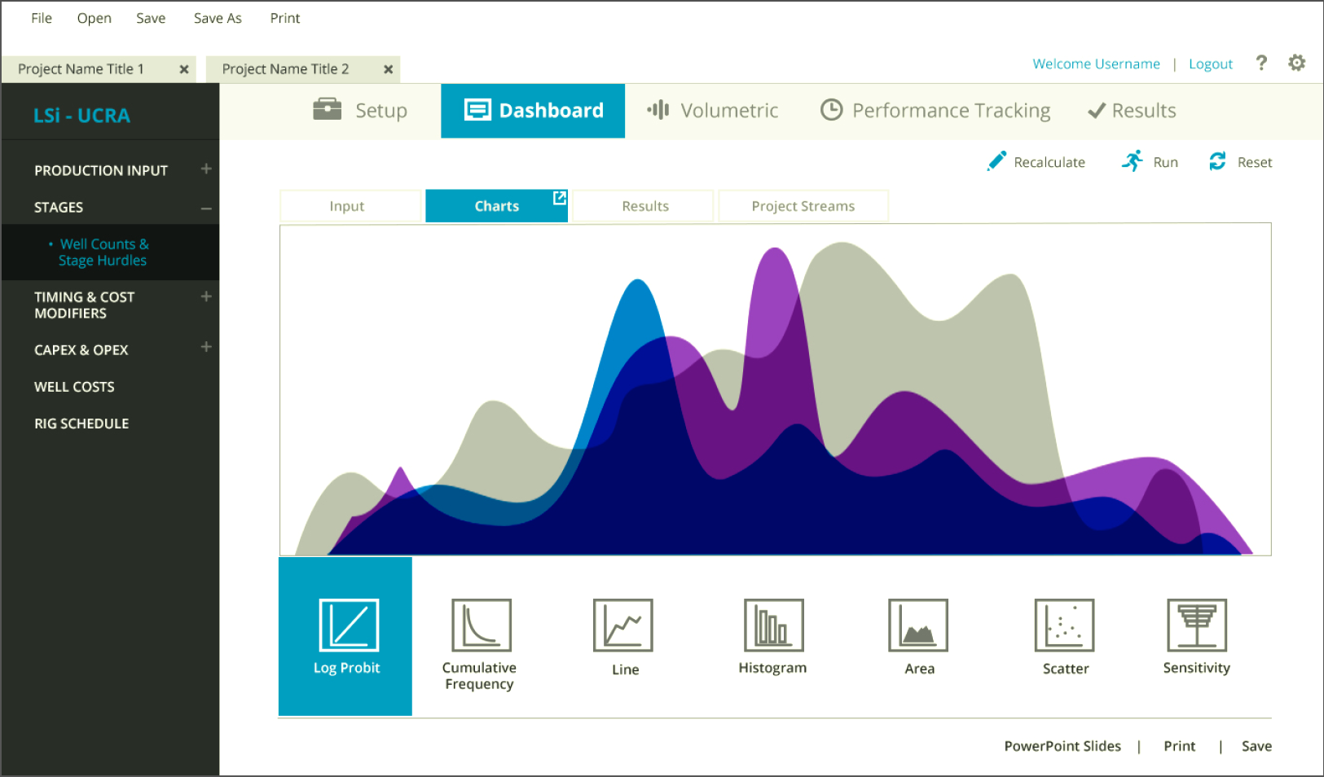
Lognormal Solutions Inc.
Results
The Challenge
LSi was utilizing an Excel tool to model resources and value for drilling opportunities. However, the simulation and aggregation capabilities needed to be expanded in order to handle the numerous unconventional exploration projects with many thousands of wells. They needed a more robust tool with a friendly user interface, that could handle different needs and be able to manipulate the data in a variety of ways.
Users now have a dynamic interface to create new probabilistic scenarios with hundreds of parameters and custom drop downs.; Increased reporting options with charting functionality; as well as, visual dashboards to track performance were also implemented.
What We Did
Affirma developed a custom user interface for LSi's newly developed application, which allows their software users to manage the different types of drilling scenarios for a particular area with a lot more flexibility,
In addition, Affirma established an effective and efficient working relationship with LSi's developer. Affirma established and guided the bulk of the frontend development work for the project, while their developer worked on the backend business logic for an overall successful collaboration.

